Slide 1

Home Loan Approval Prediction Dataset Overview

Slide 2
Dataset Overview
The dataset contains 614 rows and 13 columns representing loan application records.
Columns include: Loan_ID, Gender, Married, Dependents, Education, Self_Employed, ApplicantIncome, CoapplicantIncome, LoanAmount, Loan_Amount_Term, Credit_History, Property_Area, Loan_Status.
Data types include 8 categorical columns and 5 numerical columns.
Numerical columns: ApplicantIncome, CoapplicantIncome, LoanAmount, Loan_Amount_Term, Credit_History.
Categorical columns: Loan_ID, Gender, Married, Dependents, Education, Self_Employed, Property_Area, Loan_Status.

Slide 3
Simple description of each column in your dataset:
Loan_ID: A unique identifier assigned to each loan application.
Gender: Gender of the applicant (Male/Female).
Married: Indicates whether the applicant is married (Yes/No).
Dependents: Number of dependents the applicant has.
Education: Educational background of the applicant (Graduate / Not Graduate).
Self_Employed: Indicates whether the applicant is self-employed (Yes/No).
ApplicantIncome: Monthly income of the primary applicant.
CoapplicantIncome: Monthly income of the co-applicant, if any.
LoanAmount: Amount of loan requested by the applicant (in thousands).
Loan_Amount_Term: Duration of the loan repayment period (in months).
Credit_History: Credit history status of the applicant (1 = good credit history, 0 = poor credit history).
Property_Area: Type of area where the property is located (Urban, Semiurban, Rural).
Loan_Status: Final loan approval status (Y = Approved, N = Not Approved).

Slide 4
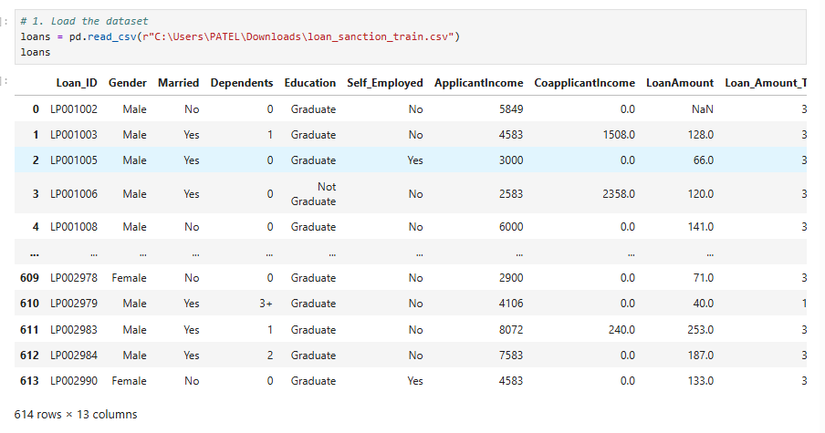
Reading Dataset

Slide 5
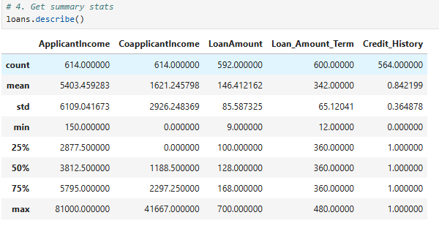
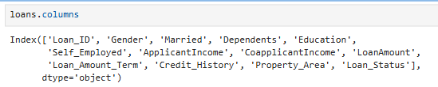
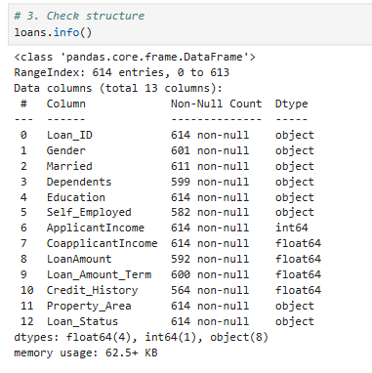
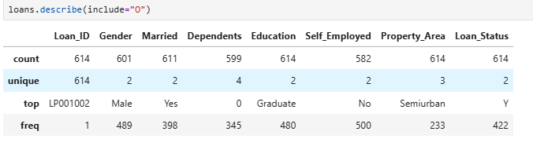
Basic Checks
Checking Summary Statistics of Numerical Columns
Columns of the Dataset
Checking Structure of the Dataset
Checking Summary Statistics of Categorical Column

Slide 6
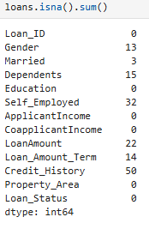

Preprocessing Techniques on Dataset Individual Columns
• 7 Columns have Missing Values
• No duplicates
• Now ,I want to perform some Preprocessing Techniques on
columns like:
✔ Handling Missing Values
✔ Handling Inconsistent Data
✔ Data Type Conversions

Slide 7
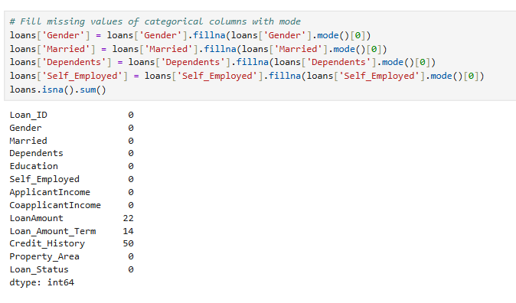
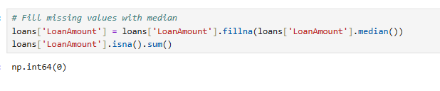
Handling Missing Values
For missing values of the categorical data columns like
Gender
Married
Dependents
self Employed
We replaced missing values of all categorical columns with mode.
Column: Loan Amount
We replaced missing values of Loan Amount with Median.

Slide 8
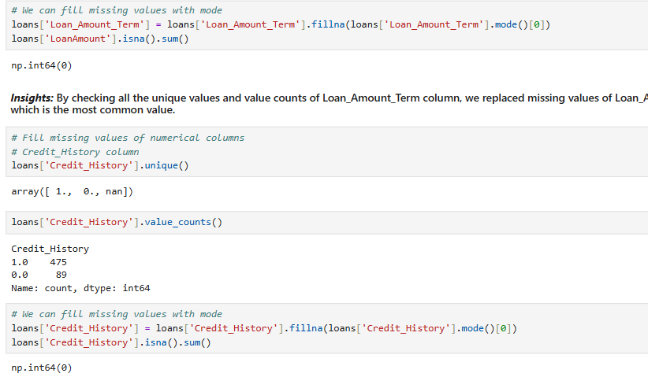
Column: Loan_Amount_Amount
We replaced missing values of Loan_Amount_Amount with Mode.
Column: Credit_History
We replaced missing values of Credit_History with Mode.

Slide 9
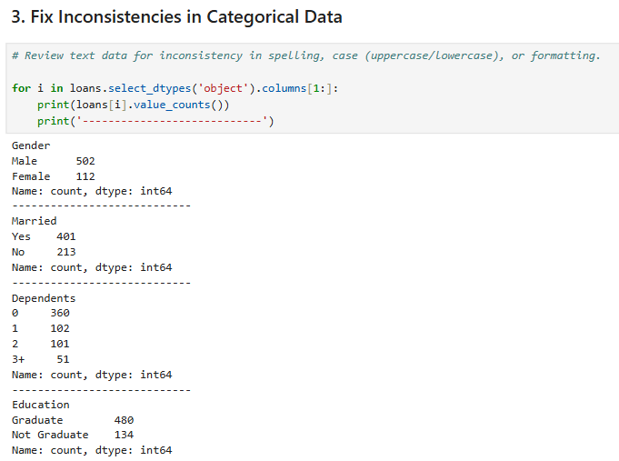
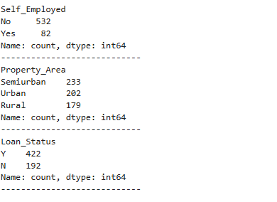
Fixing Inconsistencies
There are no inconsistencies in the Dataset

Slide 10
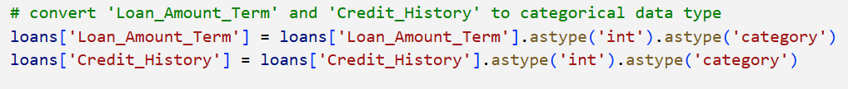
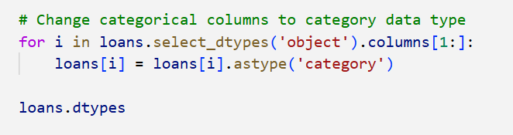
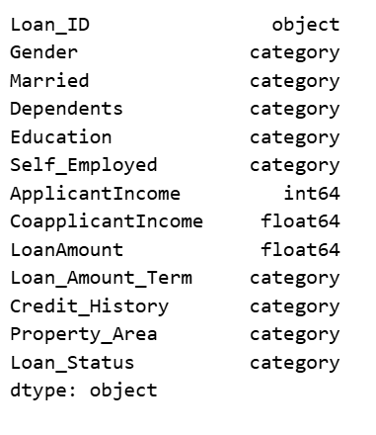
Performing Data Conversions
We converted all the object columns to category data type except the Loan_ID column and the Loan_Amount_Term and Credit_History columns to category data type.

Slide 11
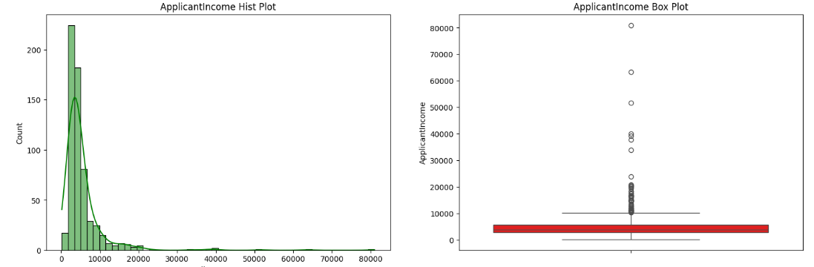
Data Analysis through Visualizations
Univariate Analysis
ApplicantIncome:
The distribution is strongly right-skewed.
Most applicant incomes lie between 0 and 5,000.
The median ApplicantIncome is approximately 3,800, which lies well within the 0–5,000 range.
Several extreme outliers are present, with incomes extending up to 80,000.

Slide 12
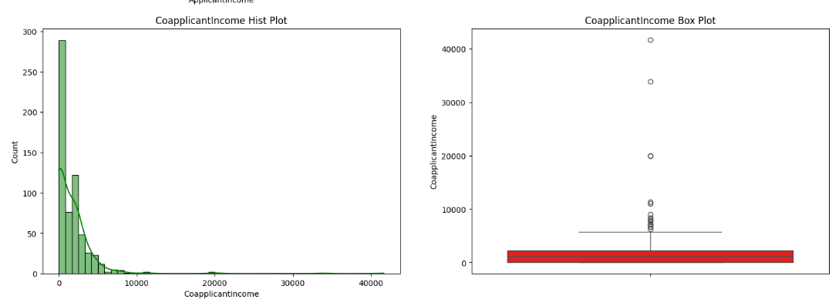
CoapplicantIncome:
The distribution is highly right-skewed with a large spike at 0.
The median CoapplicantIncome is approximately 1,200.
Most values fall between 0 and 4,000, with a long tail extending up to 41,000.
Multiple outliers suggest some applicants rely heavily on co-applicant income.

Slide 13
Similarly,
LoanAmount:
The distribution is moderately right-skewed.
The median LoanAmount is approximately 128.
Most loan amounts fall between 100 and 200.
Several high-value outliers are present, with loan amounts reaching up to 700.
Loan_Amount_Term:
The distribution is highly concentrated, with a strong peak at 360 months, indicating that this is the most common loan tenure.
The median Loan_Amount_Term is 360 months, showing that half of the loans are issued for a 30-year duration.
Shorter loan terms (such as 12, 36, 60, and 120 months) are present but occur far less frequently.
A few outliers exist at very low and very high tenures (up to 480 months), indicating some non-standard loan agreements

Slide 14
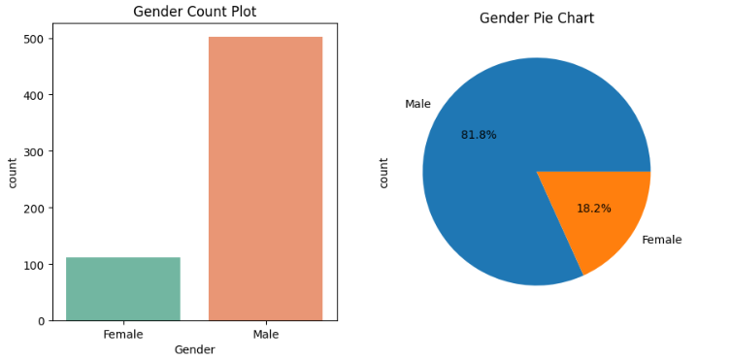
Categorical Columns:
Gender
The dataset is male-dominated, with 81.8% Male and 18.2% Female applicants.
This imbalance suggests that loan applications are more commonly submitted by males.
Gender-based analysis may reflect societal or employment patterns influencing loan access.

Slide 15
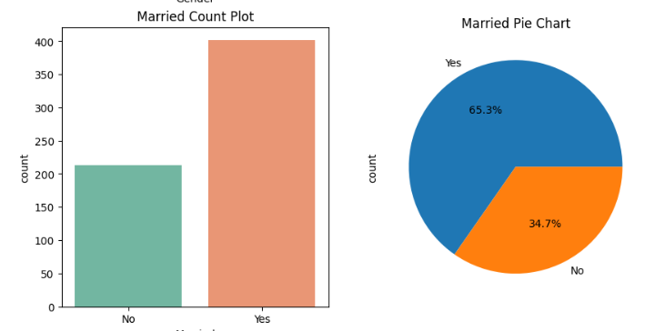
Married
A majority of applicants are Married (65.3%), while 34.7% are Not Married.
Married applicants form nearly two-thirds of the dataset, indicating household-based borrowing is common.
This may relate to combined income or family financial responsibilities.

Slide 16
Education
Graduates dominate the dataset (78.2%), compared to 21.8% Not Graduates.
This suggests that higher education levels are more prevalent among loan applicants.
Education may indirectly influence income levels and loan eligibility.
Self_Employed
Most applicants are Not Self-Employed (86.6%).
Only ~13.4% are self-employed, indicating salaried individuals form the majority.
Lenders may encounter fewer self-employed applicants due to income stability concerns.
Property_Area
Applicants are fairly distributed across areas:
Semiurban: 37.9%
Urban: 32.9%
Rural: 29.2%
Semiurban areas contribute the highest number of applicants.
This suggests growing credit demand in semiurban regions.

Slide 17
Loan_Status (Target Variable)
68.7% loans are Approved (Y), while 31.3% are Rejected (N).
The approval rate is relatively high, indicating favorable lending conditions.
This imbalance should be considered during predictive modeling
Dependents
Applicants with 0 dependents dominate (58.6%).
Applicants with 1 (16.6%) and 2 (16.4%) dependents form similar proportions.
3 dependents (8.3%) is the least common category.
Smaller household sizes are more frequent among loan applicants.
Credit_History
A strong majority of applicants have good credit history (1.0) 85.5%.
Only 14.5% have poor or missing credit history (0.0).
Credit history is highly skewed toward positive values, highlighting its importance in loan approval.

Slide 18
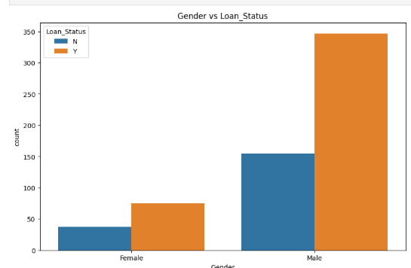
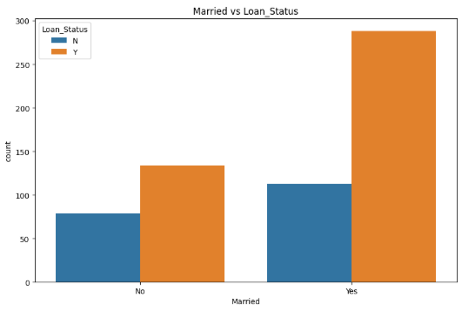
Bivariate Analysis-Categorical and Categorical
Gender vs Loan Status
Male applicants receive significantly more loan approvals compared to female applicants.
For both genders, approved loans (Y) are higher than rejected loans (N).
This suggests a higher participation and approval rate among males, possibly due to income or employment differences.
Married vs Loan Status
Married applicants have a much higher loan approval rate than unmarried applicants.
While unmarried applicants also receive approvals, the proportion is lower.
This indicates that marital status may positively influence loan approval, possibly due to dual income or financial stability.

Slide 19
Similarly,
🔹 Dependents
Applicants with fewer dependents have higher loan approval chances.
🔹 Education
Graduates receive more loan approvals than non-graduates.
🔹 Self-Employed
Salaried applicants are approved more often than self-employed applicants.
🔹 Credit History
Good credit history is the strongest factor for loan approval.
🔹 Loan Amount Term
Loan term has little to no impact on approval decisions.
🔹 Property Area
Semiurban and Urban applicants have higher approval rates than Rural.

Slide 20
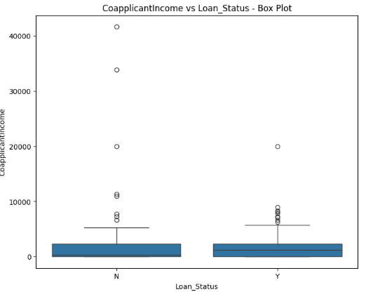
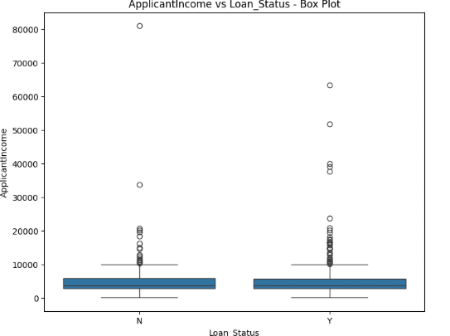
Bivariate Analysis-Categorical and Numerical
🔹 Applicant Income
Median income is similar for approved and rejected loans.
High income alone does not guarantee approval.
🔹 Coapplicant Income
Approved loans show slightly higher coapplicant income.
Additional income support improves approval chances.

Slide 21
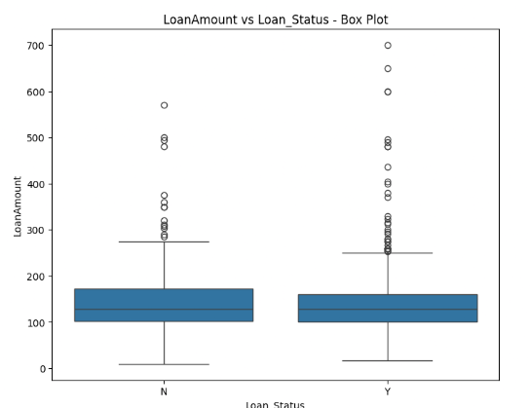
LoanAmount & Loan Status
Approved loans tend to have a slightly lower average loan amount than rejected loans.
Larger loan amounts appear more frequently among rejected applications.
This suggests that higher loan demand may reduce approval chances.

Slide 22
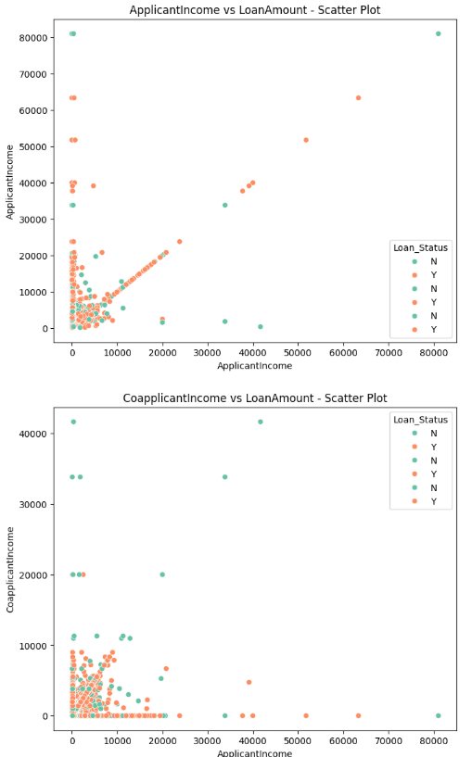
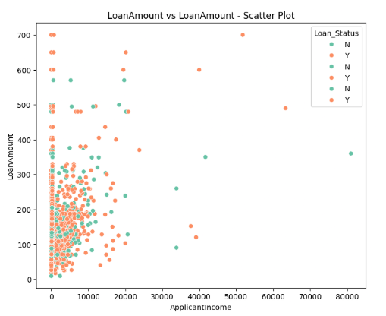
Bivariate Analysis-Numerical and Numerical
Applicant Income
Loan approvals occur across all income levels.
High income alone does not ensure approval.
Coapplicant Income
Presence of coapplicant income supports approval chances.
Zero or low coapplicant income appears more in rejections.
Coapplicant Income
Approved loans are mostly concentrated around lower to mid-range loan amounts.
Higher loan amounts show more scattered rejections, suggesting increased risk.

Slide 23
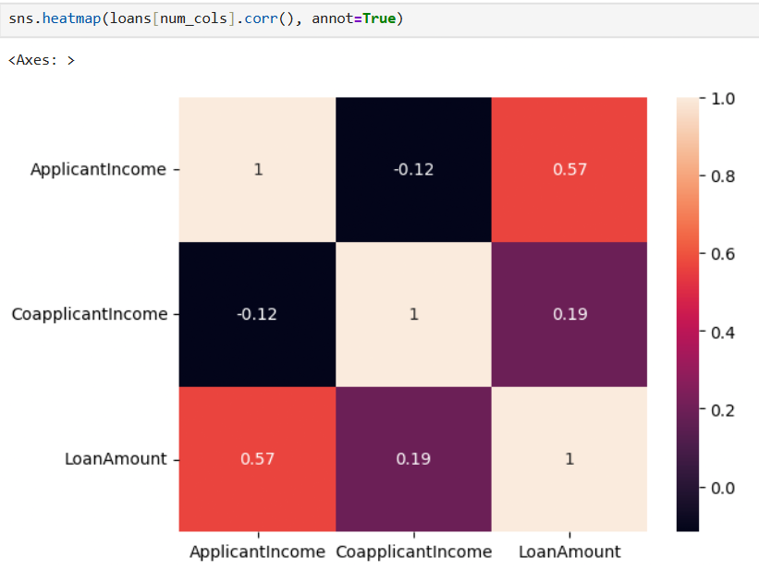
Multivariate Analysis
Correlation Insight
ApplicantIncome and LoanAmount show a moderate positive correlation (0.57), meaning higher income often leads to higher loan requests.
CoapplicantIncome and LoanAmount show a moderate positive correlation (0.50), indicating that coapplicant income has a positive impact on loan approval.
Overall, numerical variables influence loan approval indirectly, with credit history and categorical factors likely playing a stronger role.

Slide 24
Final Summary and Conclusion
This project conducted a comprehensive Exploratory Data Analysis (EDA) on the Home Loan Approval dataset to understand the key factors influencing loan approval decisions and applicant behavior.
Key Analytical Steps:
Data preparation ensured clean, consistent, and duplicate-free records by handling missing values and correcting data types.
Univariate analysis examined the distribution of individual variables such as gender, marital status, education, dependents, applicant income, loan amount, credit history, property area, and loan status.
Bivariate analysis (visual and non-visual) explored relationships between:
- Credit history and loan approval status
- Applicant income and loan amount
- Education, employment type, and loan approval
- Property area and approval trends
Categorical analysis focused on understanding approval patterns across demographic and socioeconomic groups.
Numerical analysis evaluated correlations among income, loan amount, and loan term to identify financial behavior patterns.

Slide 25
Key Insights
Credit history is the strongest predictor of loan approval, with applicants having a good credit record being approved in most cases.
Applicant income influences the loan amount requested, but does not strongly determine approval by itself.
Graduates and salaried (non-self-employed) applicants show higher approval rates, indicating preference for financial stability.
Married applicants and those with fewer dependents tend to have better approval outcomes.
Semiurban and urban property areas exhibit higher loan approval rates compared to rural areas.
A higher cost (loan amount) does not necessarily reduce approval when credit history is strong.
Final Outcome
Applicants with strong credit history, stable employment, and balanced financial profiles emerge as the most likely candidates for loan approval.
The analysis shows that lenders prioritize risk mitigation factors over income alone, emphasizing long-term repayment reliability.
Conclusion
The Loan Approval dataset demonstrates that loan eligibility is multidimensional, driven primarily by creditworthiness, supported by education, employment stability, and demographic factors.
Effective lending decisions should balance financial indicators and applicant stability rather than relying solely on income levels.
This EDA provides a solid foundation for predictive modeling, credit risk assessment, and policy optimization in future work.

Slide 26

Thank You

